Slide 1
CS 540 Network Architecture
Lecture 6: Routers
Prof. Younghee Lee
Some part of this teaching materials are prepared referencing the lecture note made by F. Kurose and Keith W. Ross

Slide 2
Delay in packet-switched networks
packets experience delay on end-to-end path
four sources of delay at each hop
nodal processing:
check bit errors
determine output link
queueing
time waiting at output link for transmission
depends on congestion level of router
transmission
A
propagation
B
nodal
processing
queueing

Slide 3
Delay in packet-switched networks
Transmission delay:
R=link bandwidth (bps)
L=packet length (bits)
time to send bits into link = L/R
Propagation delay:
d = length of physical link
s = propagation speed in medium (~2x10⁸ m/sec)
propagation delay = d/s
Note: s and R are very different quantitites!
transmission
A
propagation
B
http://wps.aw.com/aw_kurose_network_2/0,7240,227091-,00.html
nodal
processing
queueing

Slide 4
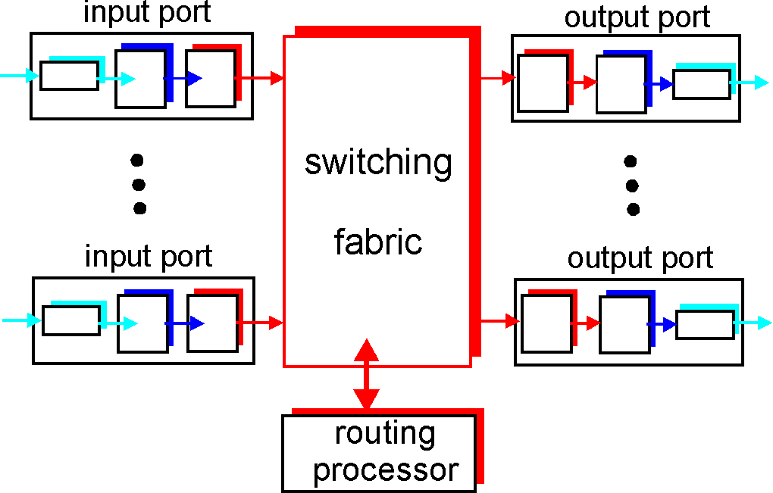
Router Architecture Overview
Two key router functions:
run routing algorithms/protocol (RIP, OSPF, BGP)
switching datagrams from incoming to outgoing link

Slide 5
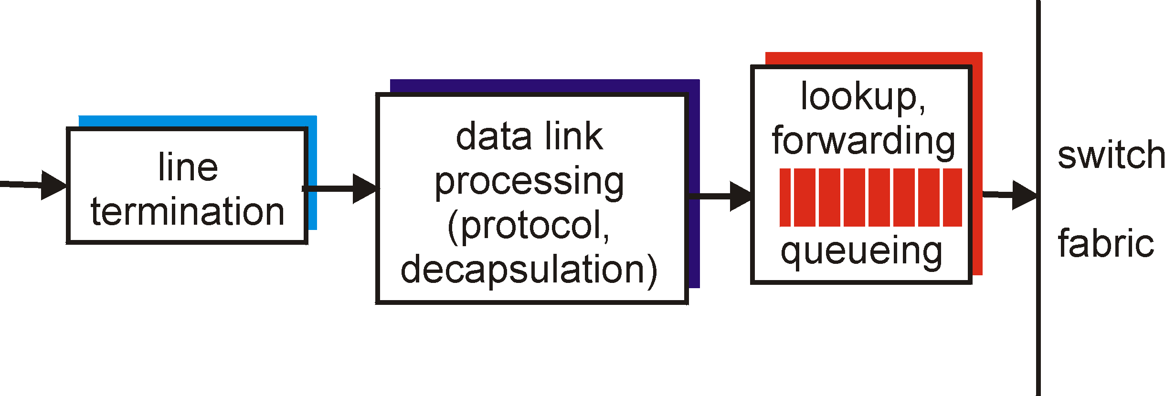
Input Port Functions
Physical layer:
bit-level reception
Data link layer:
e.g., Ethernet
Decentralized switching:
given datagram dest., lookup output port using routing table in input port memory
goal: complete input port processing at ‘line speed’
queuing: if datagrams arrive faster than forwarding rate into switch fabric

Slide 6
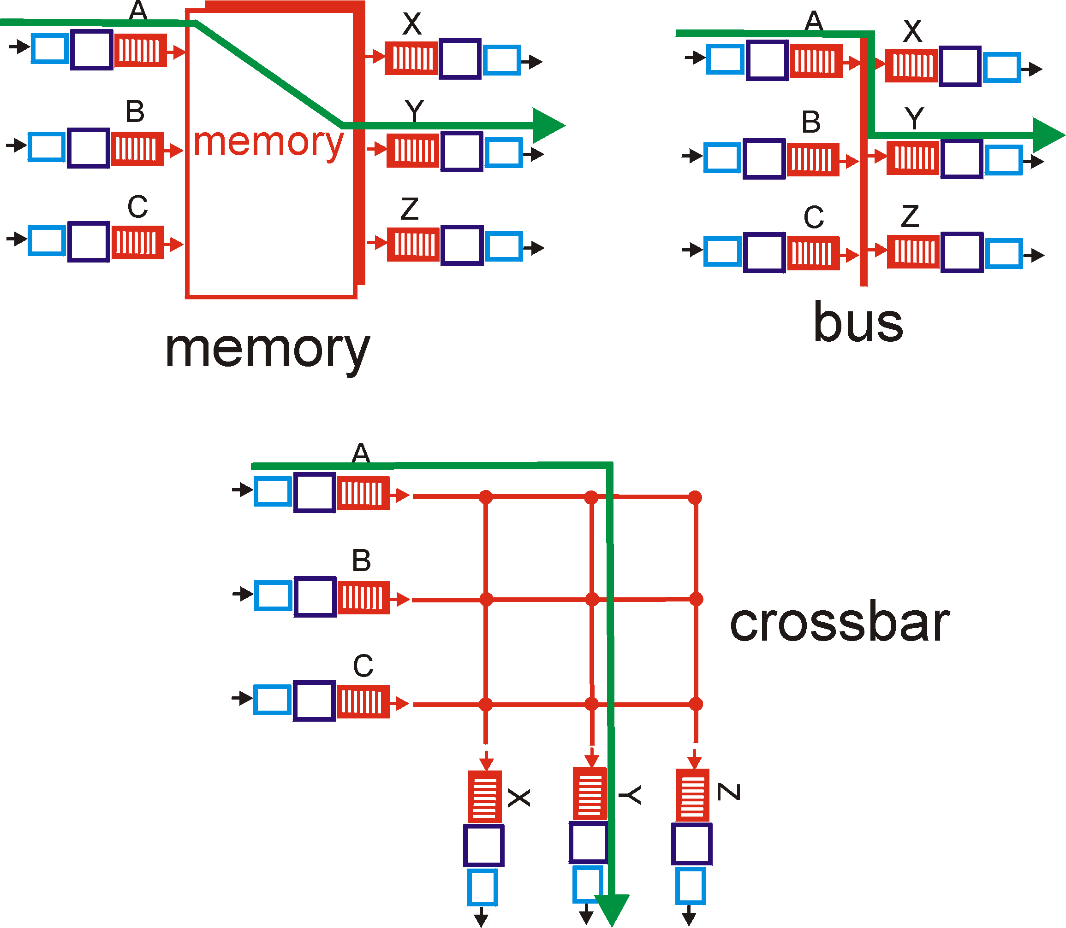
Three types of switching fabrics

Slide 7
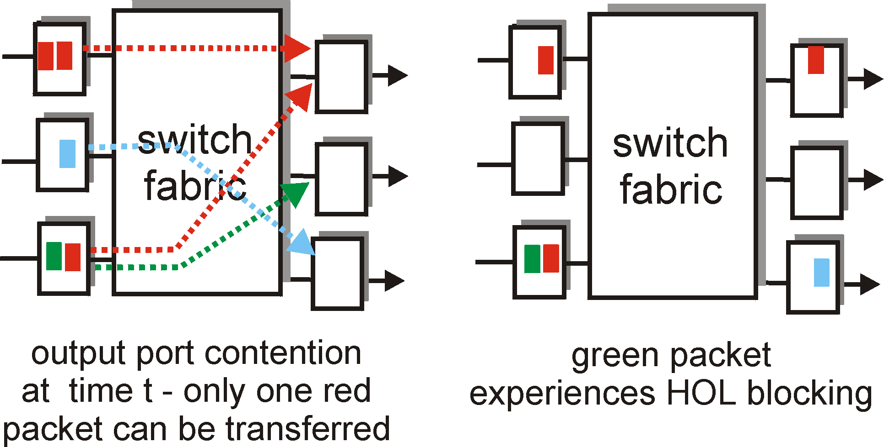
Input Port Queuing
Fabric slower that input ports combined -> queueing may occur at input queues
Head-of-the-Line (HOL) blocking: queued datagram at front of queue prevents others in queue from moving forward
queueing delay and loss due to input buffer overflow!

Slide 8
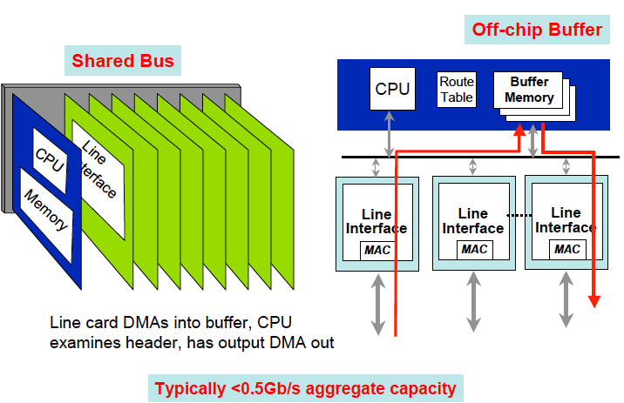
First Generation Router (memory)
From lecture note of
Dave Andersen

Slide 9
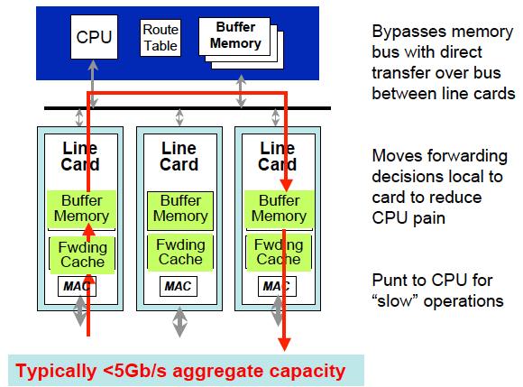
Second Generation Router (bus)
Bottle Nexk
From lecture note of
Dave Andersen

Slide 10
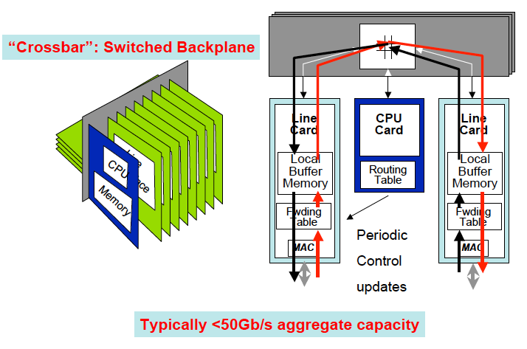
Third Generation Router (crossbar)
Scheduler
- input/output port to connect in a given
time slot
(If input I is connected to output j, no other input connected to j,… )
Wave front scheduler
Parallel iterative matching
iSLIP: round robin PIM
Head of Line Blocking
FIB
Data plane
Smaller
RIB
Control plane
Huge routing information
From lecture note of
Dave Andersen

Slide 11
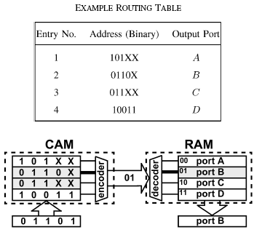
Lookup mechanism
Exact match search:
MPLS, ATM..
Direct lookup
Associative lookup: Content Addressable Memory (CAM)
Ternary CAM: 0, 1, x x: “don’t care”
Hashing vs. binary search
Perfect hash function <= not easy, Update <= complex
Multiple hash function to avoid collision
Binary search tree
Longest Prefix match
IP
Not just one entry that matches a destination
e.g., packet destination address: 143.248.56.45
Entry 143.248.56.80/24 vs. 143.248.34.45/16 which one?
Notes:
Locally connected nodes generate link-local addresses and can communicate on a shared link
Router sends Advertisement, nodes learn of global prefix and generate a global address
Site renumbering is supported by deprecation of global prefixes

Slide 12
Longest Prefix Match: is Harder than Exact Match
The destination address of an arriving packet does not carry with it the information to determine the length of the longest matching prefix
Hence, one needs to search among the space of all prefix lengths; as well as the space of all prefixes of a given length
Metrics for Lookup Algorithms
Speed (= number of memory accesses)
Storage requirements (= amount of memory)
Low update time (support ~5K updates/s)
Scalability
With length of prefix: IPv4 unicast (32b), Ethernet (48b), IPv4 multicast (64b), IPv6 unicast (128b)
With size of routing table: (sweetspot for today’s designs = 1 million)
Flexibility in implementation
Low preprocessing time

Slide 13
Longest Prefix Match
LPM in IPv4 Use 32 exact match algorithms for LPM!
Exact match
against prefixes
of length 1
Exact match
against prefixes
of length 2
Network Address
Port
Priority
Encode
and pick
Exact match
against prefixes
of length 32

Slide 14
Lookup schemes
Linear search
N: number of entries, W: Prefix length
O(N) storage, O(N) lookup time, O(1) update complexity
80k entries => worst case 80k lookup time? Too much long time!
Radix trie
O(NW) storage, O(W) lookup, O(W) update complexity
PATRICIA trie
Less storage
Caching
Skipping LPMs
Packet train exhibit temporal locality
What kind of problem?
Some part of this teaching materials are prepared referencing the lecture note made by Pankaj Gupta Department of Computer Science Stanford University

Slide 15
Tree, Tries
Trie: Prefix tree
Binary search trie: use binary tree paths to encode prefixes
Advantage: simple to implement
Disadvantage: one lookup may take O(w), where w is number of bits (32 in the case of IPv4)
<
>
0
1
<
>
<
log₂N
001xx 2
0100x 3
10xxx 1
01100 5
0
1
0
>
<
>
1
<
<
1
0
1
2
0
0
N entries
3
0
Binary search tree
Binary search trie
5
Prefix tree

Slide 16
Skip Count vs. Path Compression
0
1
(Skip count) Skip 2
or
11 (path compressed)
P1
0
1
0
1
P2
P1
1
0
P2
0
1
0
1
P3
P4
P3
P4
Removing one way branches ensures # of trie nodes is at most twice # of prefixes; (case: trie containing a small number of very long strings)
Patricia tries: Practical Algorithm To Retrieve Information Coded In Alphanumeric, also called as Radix trie or Radix tree: In contrast with a regular trie, the edges of a Patricia trie are labelled with sequences of characters
Using a skip count requires exact match at end and backtracking on failure → path compression simpler

Slide 17
Radix Trie
Trie node
A
next-hop-ptr (if prefix)
1
B
left-ptr
right-ptr
1
C
0
D
Add P5=1110*
P1 | 111* | H1
P2 | 10* | H2
P3 | 1010* | H3
P4 | 10101 | H4
P2
1
1
E
F
P1
G
0
0
P3
P5
I
Some part of this teaching materials are prepared referencing the lecture note made by Pankaj Gupta Department of Computer Science Stanford University
1
H
Lookup 10111
P4

Slide 18
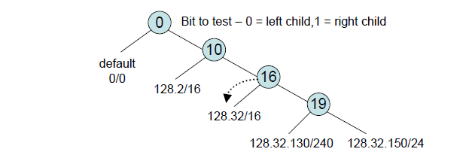
PATRICIA Tries
Arrange route entries into a series of bit tests
0123 4567 89. . .
128.2/16
128.32/16
128.32.130/24
128.32.150/24
1000 0000 0000 0010 xxxx xxxx xxxx xxxx
1000 0000 0010 0000 xxxx xxxx xxxx xxxx
1000 0000 0010 0000 1000 0010 xxxx xxxx
1000 0000 0010 0000 1001 0110 xxxx xxxx

Slide 19
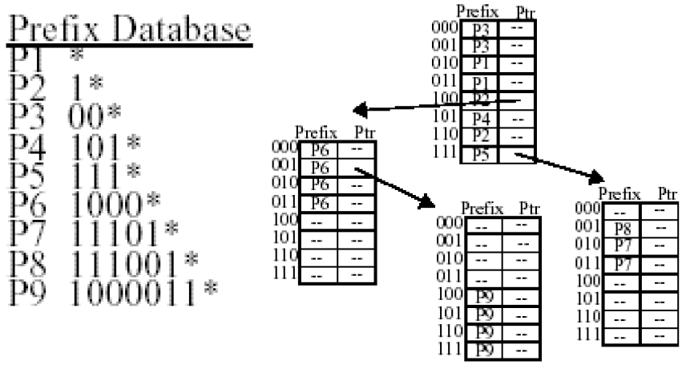
Multibit Tries
Binary trie
Depth: w, Degree: 2, Stride: 1bit
Multi-bit trie
Depth: w/k, Degree: 2^{k}, Stride: k bits
Reduce lookup step to almost(due to expansion) 1/k
Expanded trie
If stride = k bits, prefix lengths that are not a multiple of k need to be expanded
To speed up lookup, branch on multiple bits at each decision instead of just one.
The number of bits used is the “stride length”
Expansion uses up more space
Also, each entry requires two fields : because some entries require both a pointer and a prefix; i.e. P2, P5, and P6
Update speed versus memory size tradeoff
W/k

Slide 20
Four-ary Tries (k=2)
A
10
11
Lookup 10111
B
C
P1 | 111* | H1
P2 | 10* | H2
P3 | 1010* | H3
P4 | 10101 | H4
P2
10
11
10
D
E
F
P3
P1₁
P1₂
10
11
H
G
P4₁
P4₁
P4₂
Some part of this teaching materials are prepared referencing the lecture note made by Pankaj Gupta Department of Computer Science Stanford University
A four-ary trie node
A four-ary trie node
next-hop-ptr (if prefix)
ptr00
ptr01
ptr10
ptr11

Slide 21
Tree Bitmap
Used in high-speed routers : Cisco
Goal:
Wire-speed forwarding at OC-192(10Gbps)
Minimize memory accesses
Multibit trie
Inside of nodes: Going back to unibit tree to avoid the problems of expansion and leaf pushing

Slide 22
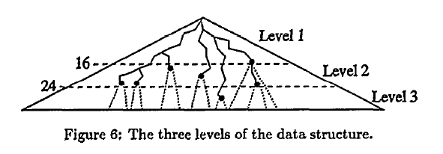
Lulea routing lookup algorithm
N = 2³² ≅ 4 x10⁹
Three level data structure to minimize number of memory accesses and size of data structure

Slide 23
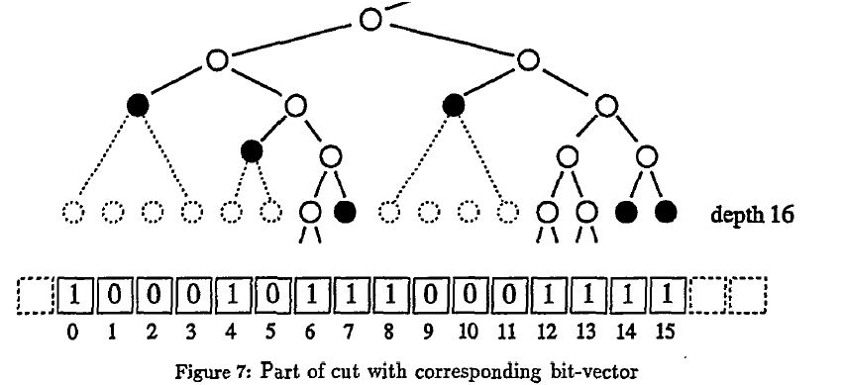
Lulea routing lookup algorithm: bit vector
xx..xx01 -> not possible
Routing table
Level2 chunks
Genuine head
Root head
Pointer array

Slide 24
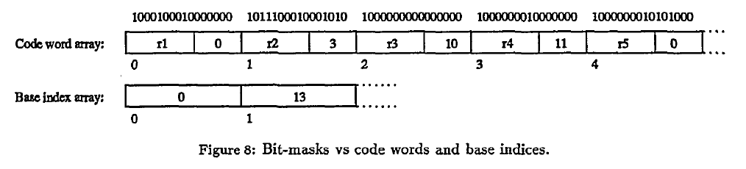
Code word, bit mask and base indices
16bits of ip address
First 12bits of ip address
bit vector
2¹⁶ = 65,536
6 bit offset
2¹⁰ x16=
16kb
First 10bit of ip address
Number of bit mask: 678 < 1024 => 10 bits are enough
bit vector => bit mask
a(n): Number of non zero bit-masks of length 2^{n}
a(0) = 1 : 1
a(1) = 1² + 1 = 2 : 11, 10
a(2) = 2² + 1 = 5 : 1111, 1110, 1011, 1010, 1000
a(3) = 5² + 1 = 26
a(4) = 26² + 1 = 677 : …………………, 1000000000000000
Number of possible bit masks: a(4) +1 = 678; 1 => 0000000000000000
xx..xx01 -> not possible

Slide 25
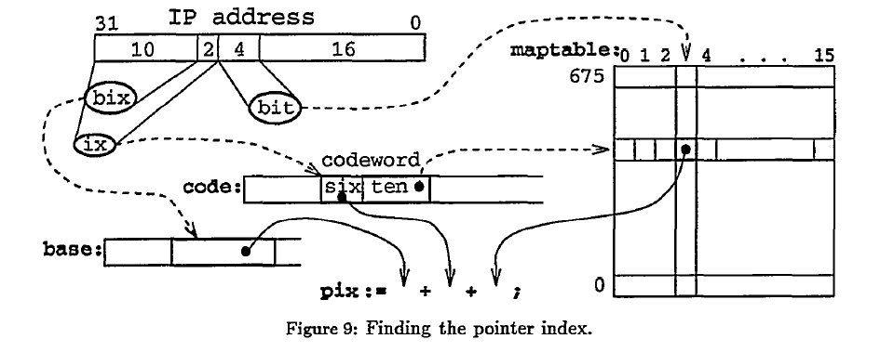
Finding the pointer index
Each entry in maptable is an offset of 4 bits: Max. No. of 1’s in bit mask is less than 16
Code word array: 64kb
Base index array: 16kb
Map table: 677 x 16 x 4 : 43,4 kb
Total : 123.3 kb => 15.5 Kbyte
3 memory access

Slide 26
Lulea routing lookup algorithm
33K entries: 160KB, average 2Mpps
Advantages
Extremely small data structure – can fit in L1/L2 cache
Disadvantages
Scalability to larger tables?
Incremental updates not supported

Slide 27
Binary Search on Prefix Intervals [Lampson98]
 | Prefix | Interval
P1 | /0 | 0000…1111
P2 | 00/2 | 0000…0011
P3 | 1/1 | 1000…1111
P4 | 1101/4 | 1101…1101
P5 | 001/3 | 0010…0011
P5
P4
P2
P3
I₁
I₂
P1
I₃
I₄
I₅
I₆
0000
0010
0100
0110
1000
1001
1010
1100
1110
1111
Notes:
This algorithm is specific to the binary search tree data structure, that was applied to longest prefix matching by Lampson et al in 1998. To understand how the data structure is built, let us look at an example forwarding table which has 5 prefixes, each up to 4-bits long. Since the maximum length is 4-bits, each prefix can be viewed as an interval on the number line that stretches from 0 to 15. While these intervals are overlapping, the endpoints of these intervals form a set of disjoint basic intervals that cover the whole number line. There are six such basic intervals in this example.
The importance of this is that one can pre-compute the longest matching prefix for every basic interval, e.g., the LPM for interval I4 is P3. Now when a packet comes in with a destination address of say 1001, it suffices to find the basic interval that contains this point, which can be done by doing a normal binary search. In this diagram, this basic interval containing 1001 is I4 for which P3 has already been pre-computed to be the longest matching prefix.

Slide 28
Binary Search Tree
 | Prefix | Interval
P1 | /0 | 0000…1111
P2 | 00/2 | 0000…0011
P3 | 1/1 | 1000…1111
P4 | 1101/4 | 1101…1101
P5 | 001/3 | 0010…0011
0111
≤
>
0011
1101
≤
>
≤
>
0001
I₃
1100
I₆
≤
>
≤
>
I₁
I₂
I₄
I₅
P5
P4
P2
P3
I₁
I₂
P1
I₃
I₄
I₅
I₆
0000
0010
0100
0110
1000
1001
1010
1100
1110
1111
Notes:
The binary search tree data structure for this example is shown here. The leaves contain the basic intervals while the internal nodes contain suitably chosen values to guide the search process from the root to the appropriate leaf node. For example, the lookup algorithm will traverse the path as shown for the incoming address 1001.
A binary search tree is also called an alphabetic tree because the leaves must appear in the same alphabetic order from left to right as they do lexicographically on the number line. The reason for this is simply because of the way binary search works by eliminating a chunk of “contiguous” search space with every comparison. E.g., if I3 and I6 were to be swapped, the lookup algorithm will perform a comparison with 0111 and if it takes the right branch, it assumes that it has eliminated the portion of search space to the left of 0111. But that assumption will be broken if I6 is to the left and I3 is to the right.
This is where previous work left off. We take this as our starting point and come back to our original motivation for high speed. And we make use of statistical information that routers keep anyway: that is, a count of the number of times a prefix was the LPM in recent history. That gives us a probability distribution on the access frequency of different intervals.
Lets take an example. Assume that I1 is accessed 50% of the time, I2 is accessed 25% of the time, and so on… Given this probability distribution, a natural question to ask is “what is a good alphabetic tree?”. Now Lampson’s paper does not give any suggestions? And that question is important because there are various alphabetic trees possible with the same sets of proabability values. For example this is one tree, another is …

Slide 29
Fast Longest Prefix Match
Lulea’s Routing Lookup Algorithm (Sigcomm’97)
use a three-level data structure
Multi-bit Tries
Controlled Prefix Expansion [Sri98]
Binary Search on Prefix Intervals [Lampson98]
Binary search on prefixes : Waldvogel – Sigcomm 97
Longest prefix matching using bloom filters – Sigcomm 2003
Route caches
Temporal locality
Many packets to same destination

Slide 30
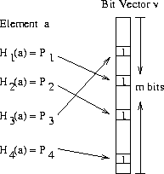


Bloom Filter
Method for representing a Set A={a₁, a₂,…a_{n}} of n elements (keys) to support membership queries.
Probability of a false positive
The right hand side is minimized for , in which case it becomes
P1th location:
Set to 1
K: number of hash functions
Figure: A Bloom Filter with 4 hash functions.

Slide 31
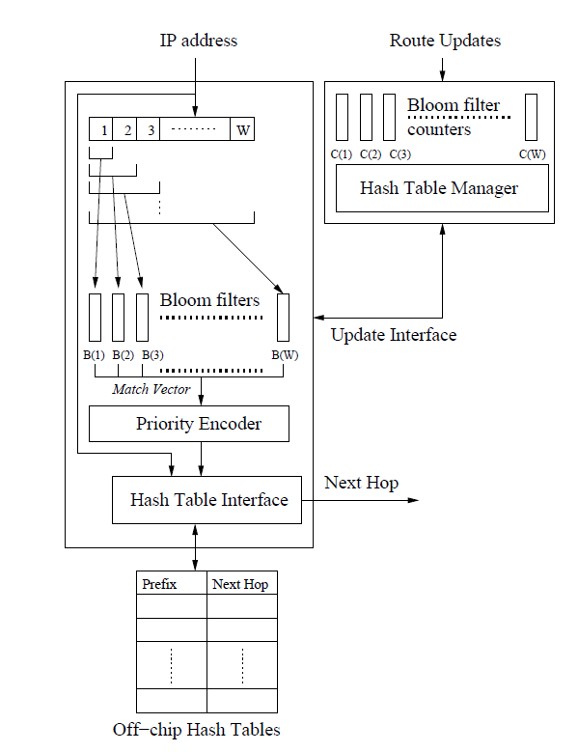
Longest Prefix Matching using Bloom Filters
Bloom filters to find matched longest prefix
Hash Table to Next Hop
Sarang Dharmapurikar, “Longest Prefix Matching Using Bloom Filters”, Sigcomm 2003
Longest Prefix
Bloom filters can also be applied to
Service discovery,
Content discovery,
…….

Slide 32
CAM for fast longest prefix match
Content addressable memory (CAM)
Hardware based route lookup
Input = tag, output = value associated with tag
Requires exact match with tag
Multiple cycles (1 per prefix searched) with single CAM
Multiple CAMs (1 per prefix) searched in parallel
Ternary CAM
0,1,”don’t care” values in tag match
Priority (I.e. longest prefix) by order of entries in CAM

Slide 33
Memory Technology
Technology | Max single chip density | $/chip ($/MByte) | Access speed | Watts/chip
Networking DRAM | Very high | Cheapest | Slow | Loweat
SRAM | High | Cheap | Fast | Low
TCAM | Low | Very expensive | Fast | Very high
Notes:
This is probably a good time for me to make a note. Throughout this lecture and next, you will find an almost continuous flip-flop between algorithmic analysis and real-world constraints. This is probably due to a lot of research in this field being done at the same time when industry was and is designing prcticl solutions. Hence, I think they have influenced each other heavily. That may be good or bad depending on one’s ambitions.

Slide 34
Performance Comparison: Complexity
Algorithm | Lookup | Storage | Update
Binary trie | W | NW | W
Patricia | W² | N | W
Path-compressed trie | W | N | W
Multi-ary trie | W/k | N*2^{k} | -
LC trie | W | N | -
Lulea | - | - | -
Binary search on trie levels | logW | NlogW | -
Binary search on intervals | log(2N) | N | -
TCAM | 1 | N | W

Slide 35
Performance Comparison
Algorithm | Lookup (ns) | Storage (KB)
Patricia (BSD) | 2500 | 3262
Multi-way fixed-stride optimal trie (3-levels) | 298 | 1930
Multi-way fixed-stride optimal trie (5-levels) | 428 | 660
LC trie | - | 700
Lulea | 409 | 160
Binary search on trie levels | 650 | 1600
6-way search on intervals | 490 | 950
Lookups with direct access | 15-60 | 9-33 * 1000
TCAM | 15-20 | 512

Slide 36
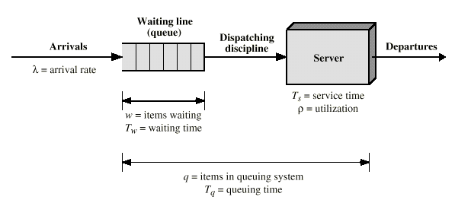
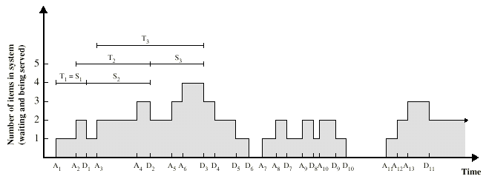
Queuing Models

Slide 37
D/D/1 Queue
Deterministic arrivals rate λ
Deterministic service rate μ
System empty at time 0
System unstable unless
λ≤ μ
If λ≤ μ system stable
E(waiting time) = 1/μ
E(number in system) = λ/μ
X/Y/N
X refers to the distribution of the interarrival times
Y refers to the distribution of service times
N refers to the number of servers
G= general independent arrivals or service time
M= negative exponential distribution
D= deterministic arrivals or fixed-length service

Slide 38
M/M/1 Queue

Slide 39
M/M/1 Queue

Slide 40
M/M/1 Queue(finite queue) (FYI)
λ
γ=λ(1-Pb)
Queue
λPb

Slide 41
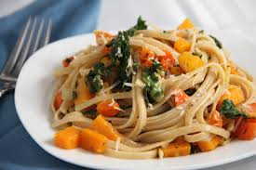
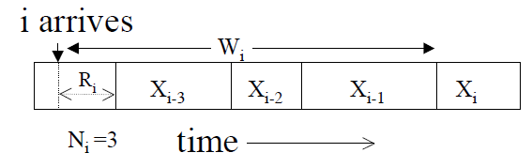
M/G/1 Queue
Poisson Arrivals See Time Averages(PASTA) property
Let P_{k} be the steady state probability for the queue having k customer(s).
Let A_{k} be the probability that the process monitor sees k customer(s) in the queue just before an arrival.
Then P_{k} = A_{k}
Residual service time r(τ)
X1
X1
X2
XM(t)
t
Time τ
P(A|B) = P(AB)/P(B)
P(A|B) = P(A), when two events are independent.
Thus P(AB) = P(A)P(B)

Slide 42
M/G/1 Queue

Slide 43
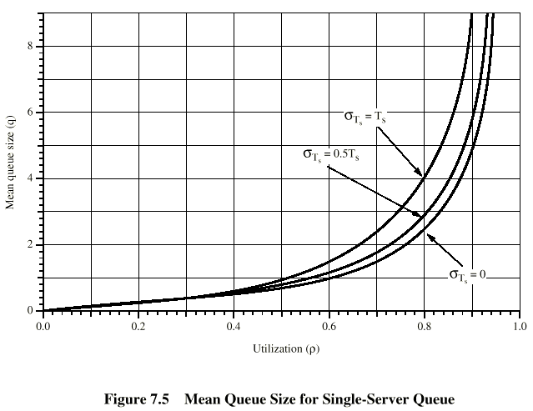
Single-Server Queues
bi-modal distribution with a wide
spread between the peeks: ratio>1
random message length: M/M/1
data entry application for a particular form
same message length: M/D/1

Slide 44
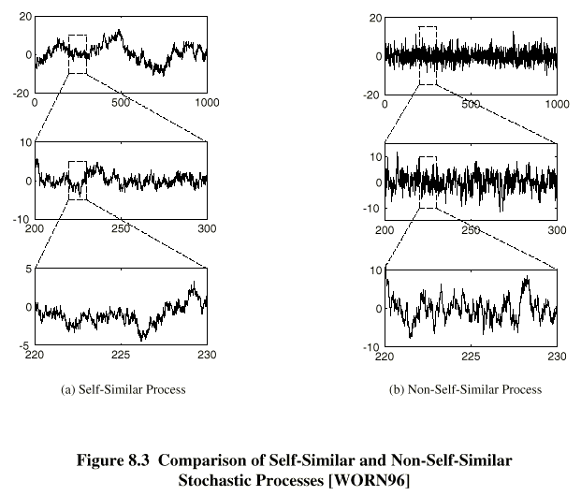
Self-Similar Data Traffic
A deterministic periodic function
g(t)=g(t+aT)
a=0,±1 ,±2…
nondeterministic self-similarity
natural landscape, distribution of earthquake, ocean waves, turbulent flow, fluctuations in stock market, pattern of errors, data traffic communication channel

Slide 45
Self-Similar Data Traffic
Continuous-time Definition(self-similar stochastic process)
H=0.5: indicates the absence of self-similarity

Slide 46
Examples of Self-similar Data Traffic
Ethernet Traffic
Basic assumption is that Ethernet bandwidth is WSS
Mean does not change with time
Variance does on change with time
Autocorrelation is only a function of ΔT
actual measurement: look the same at large scale and at small scale: H ≅ 0.9
Poisson model: each level of aggregation -> taking of a sequence of non-overlapping sample means with a sample size of 10;
stationary ergodic stochastic process
variance in the data to be reduced by a factor of 10 for each level of aggregation
Self-similar model: H=0.9
Burstiness greater when load greater
Traditional metrics for burstiness not well-defined

Slide 47
Examples of Self-similar Data Traffic
World wide Web Traffic
Traffic pattern generated by the browsers -> self-similar
On/OFF source, Pareto distribution,
α=1.16~1.5 (H=(3-α)/2)
random selection of files for transfer
file size distribution: heavy tailed
plenty of small files, large files(multimedia files)
Signaling System Number 7 Traffic
SS7: the control signal protocol used on PSTN, ISDN and other digital network
call duration: heavy tailed distribution

Slide 48
Examples of Self-similar Data Traffic
TCP, FTP, and TELNET Traffic
TCP: Poisson models underestimates the burstiness of TCP traffic
TELNET:
connection arrivals: well modeled as poisson
packet arrivals: Poisson model underestimates the burstiness
FTP:
session arrivals: well modeled as poisson
data connections: Poisson model underestimates the burstiness
the distribution of the number of bytes in each burst: heavy upper tail
plenty of small files, large files(multimedia files)

Slide 49
Examples of Self-similar Data Traffic
Variable Bit Rate Video
VBR video over ATM networks and the Internet is self-similar
frame length: Pareto distribution
encoded using the JPEC standard
star wars: scene with many action, little action…-> heavy-tailed distribution of the encoded video
long range dependence: inherent feature of VBR video traffic
Deterministic Data Transfer
deterministic data source, varied the total load, moderately complex networks -> data traffic is self similar
in a network with a number of protocol interactions between remote sources and destinations, the underlying protocols govern the dynamics of data traffic flow to produce self-similar behavior.

Slide 50
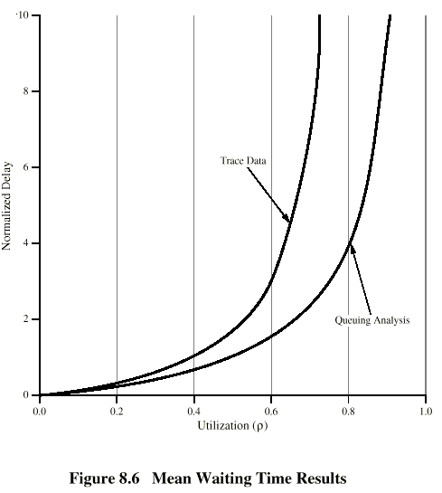
Performance Implications of Self-Similarity
Ethernet/ISDN Analysis
Poor agreement between actual waiting time and the estimated one
Ethernet data
The higher the load on the Ethernet, the higher the estimated H or, higher degree of self-similarity
traditional queuing models to predict performance of ATM switch node -> small buffers -> cell loss far beyond those expected -> applies to ATM, FR, 100BASE-T, WAN router, LAN, statistical Mux.

Slide 51
Implications for Design
Loads predictable and smooth for aggregated Poisson processes, e.g., telephony, but not for networks
More active connections means more bursty traffic
Loss/delay differ when there is long range dependence
Linear increases in buffer size don’t help greatly
Measurement-based admission control

